Slide 1

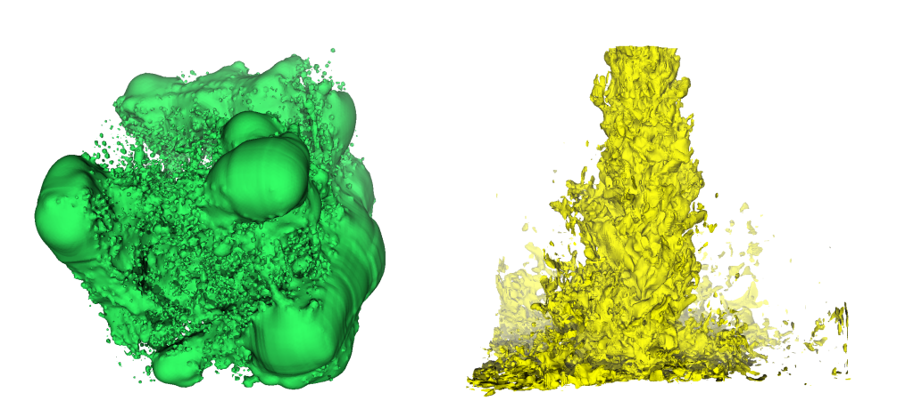
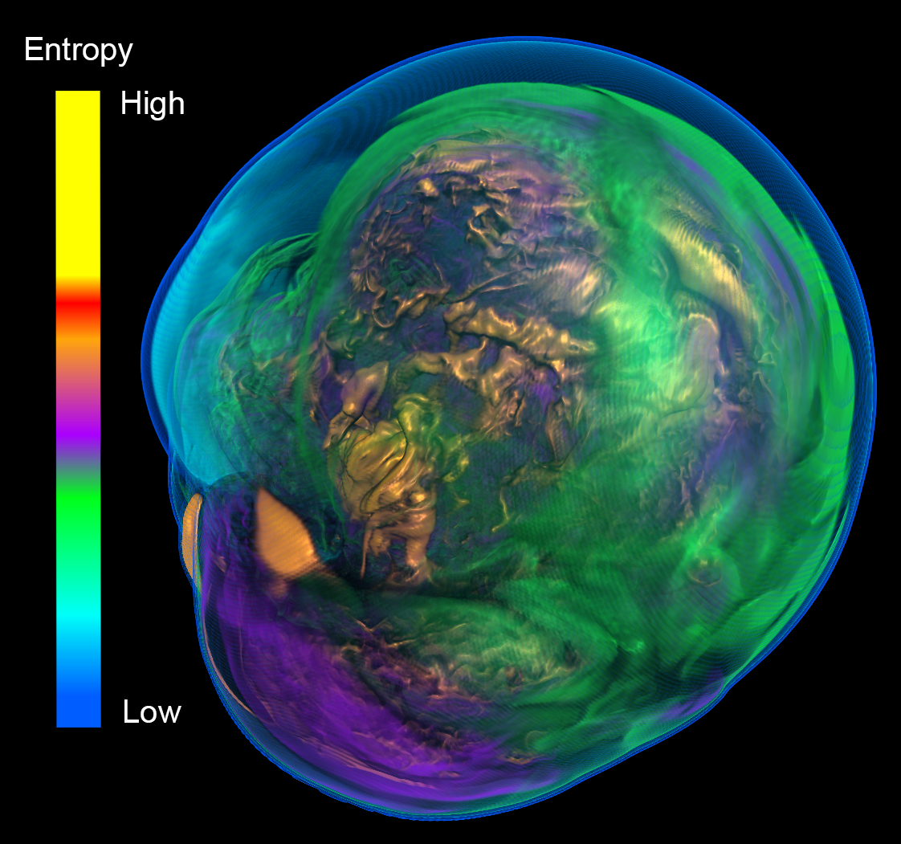
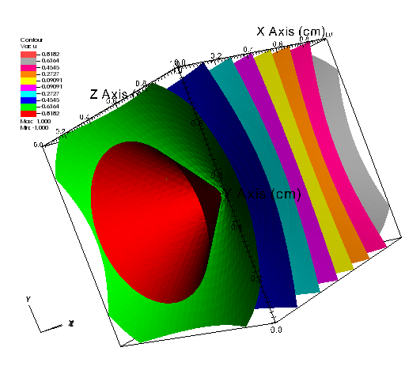
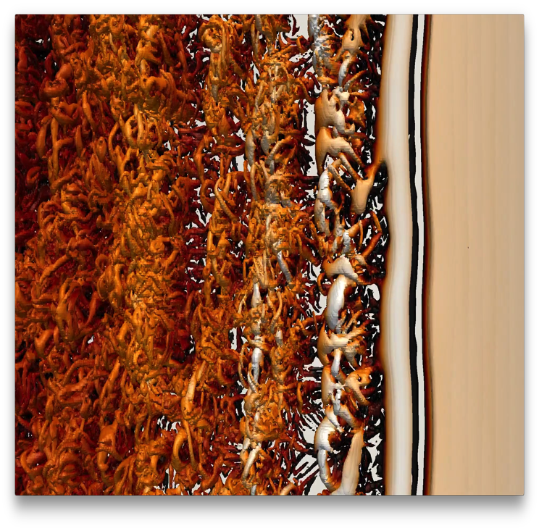
Using VTK-m
Kenneth Moreland Sandia National Laboratories
with contributions from Dave Pugmire and the rest of the VTK-m team
February 5, 2018

Slide 2


Acknowledgements
This material is based upon work supported by the U.S. Department of Energy, Office of Science, Office of Advanced Scientific Computing Research, under Award Numbers 10-014707, 12-015215, and 14-017566.
This research was supported by the Exascale Computing Project (17-SC-20-SC), a collaborative effort of two U.S. Department of Energy organizations (Office of Science and the National Nuclear Security Administration) responsible for the planning and preparation of a capable exascale ecosystem, including software, applications, hardware, advanced system engineering, and early testbed platforms, in support of the nation’s exascale computing imperative.
Sandia National Laboratories is a multimission laboratory managed and operated by National Technology and Engineering Solutions of Sandia, LLC., a wholly owned subsidiary of Honeywell International, Inc., for the U.S. Department of Energy’s National Nuclear Security Administration under contract DE-NA-0003525.
Thanks to many, many partners in labs, universities, and industry.

Slide 3
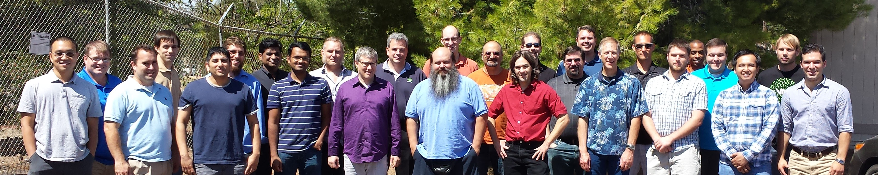
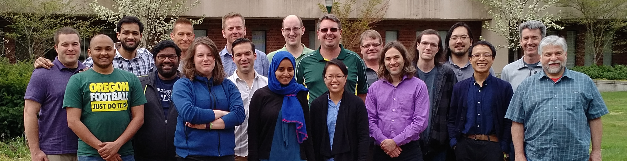
Thanks to All Our Partners!
Code Sprint, September 2015, LLNL
Code Sprint, April 2017, University of Oregon

Slide 4
Why VTK-m?

Slide 5
My new computer's got the clocks, it rocks
But it was obsolete before I opened the box
− “Weird” Al Yankovic, It’s All About the Pentiums, circa 1999
Moore’s Law is dead.
− Gordon Moore, circa 2005
Notes:
Why is this happening now?
In previous years we enjoyed a doubling of clock rate every 18 months
Frustrating to computer buyers but great for HPC
(Technically, it’s Dennard scaling, that power in transistors drops as they shrink, that is dead.)
Now, clock rates have leveled off at 2-4 GHz
Manufactures compensate by adding more cores, more parallelism

Slide 6
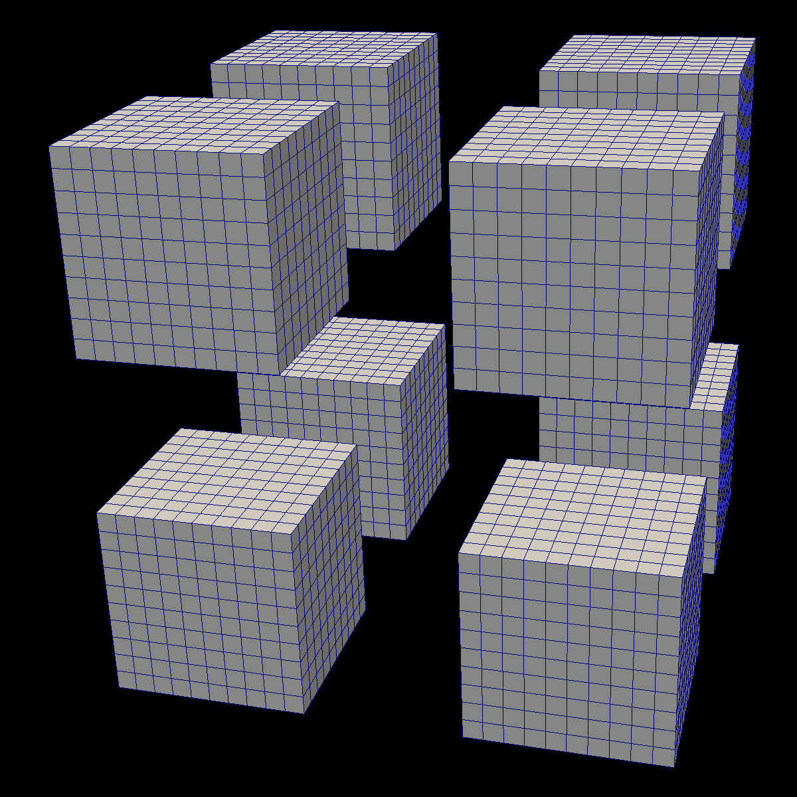
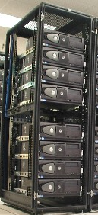


Distributed
Parallelism
ALPINE/
ASCENT

Slide 7
Distributed
Parallelism
ALPINE/
ASCENT
On Node
Parallelism

Slide 8

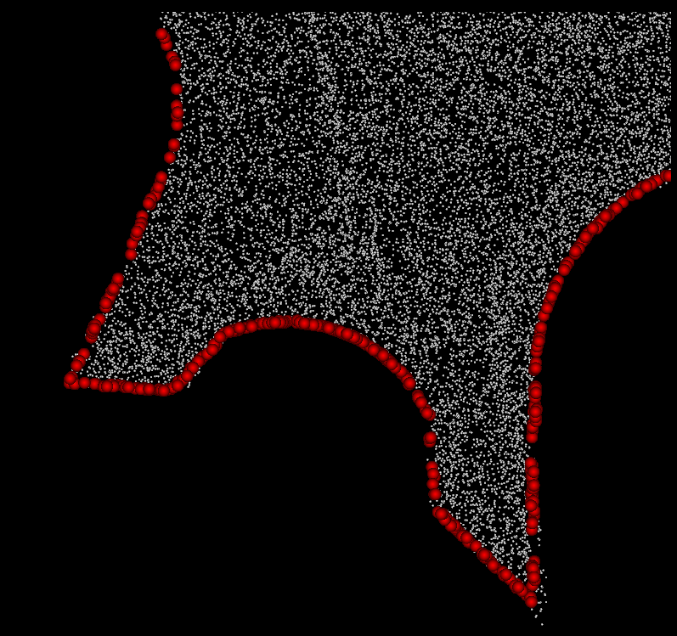
VTK-m is separate from VTK
Algorithm
Simulation

Slide 9

VTK-m is not a replacement for VTK
Algorithm
Filter
Simulation

Slide 10
Reader
Filter
Algorithm
Filter
Simulation
Filter
Rendering

Slide 11
How Do I Use VTK-m?

Slide 12
How Do I Use VTK-m?
I use tools like ParaView, VisIt, Catalyst, Libsim, ASCENT, etc.
I develop software that uses (or will use) visualization libraries.
I develop visualization software and want to make the leap to many-core devices.

Slide 13
How Do I Use VTK-m?
I use tools like ParaView, VisIt, Catalyst, Libsim, ASCENT, etc.

Slide 14
Reader
Filter
Algorithm
Filter
Simulation
Filter
Rendering

Slide 15
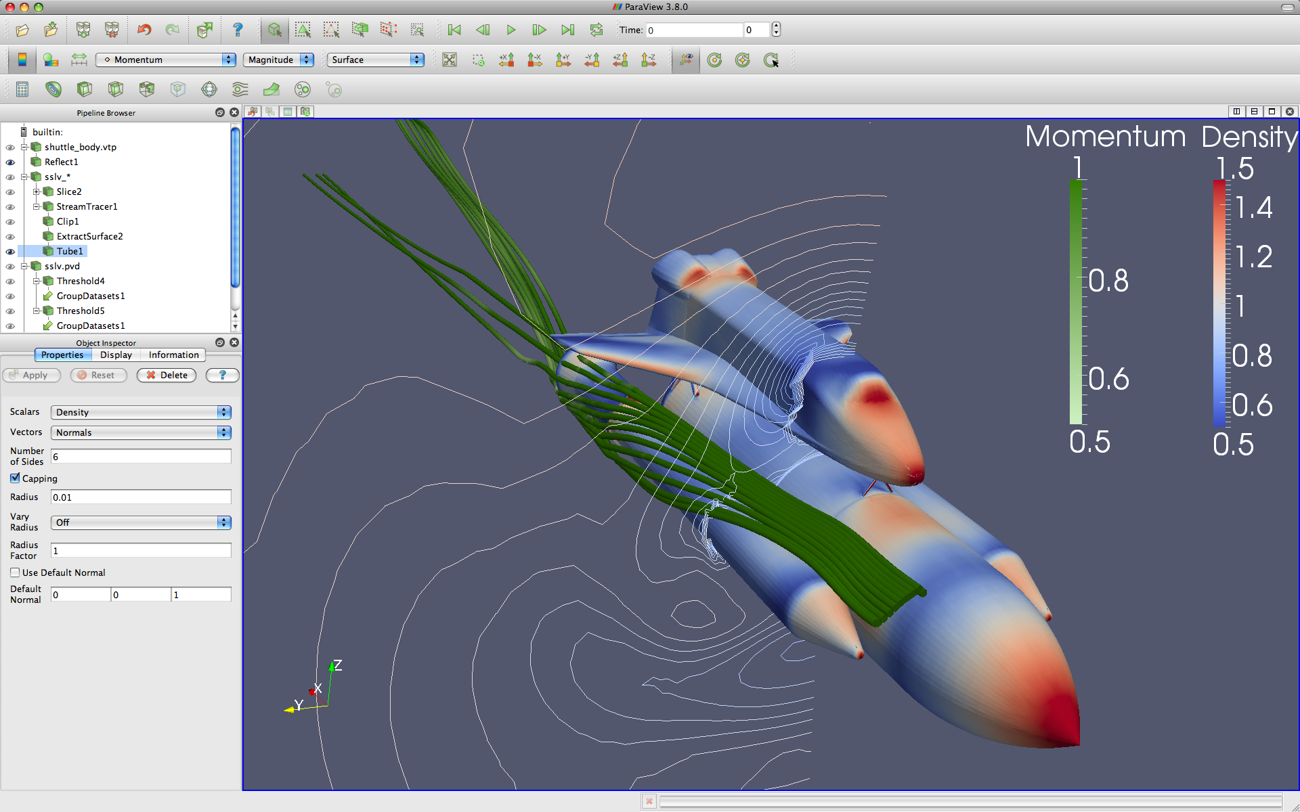
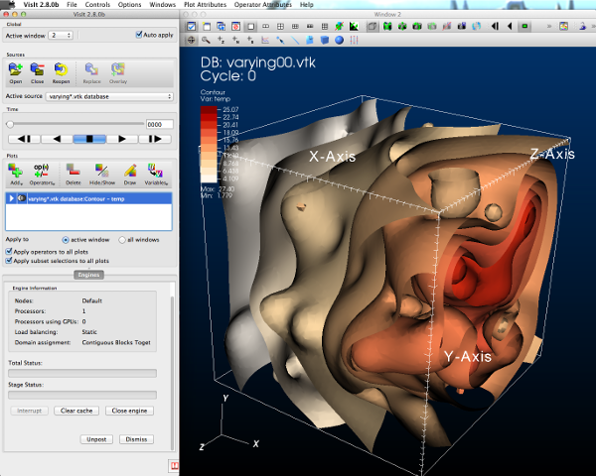

Reader
Filter
Algorithm
Filter
Simulation
Filter
Rendering

Slide 16



GUI / Parallel Management
Simulations
In Situ Vis Library
(Integration with Sim)
Base Vis Library
(Algorithm Implementation)
Libsim
ASCENT
Multithreaded Algorithms
Processor Portability

Slide 17
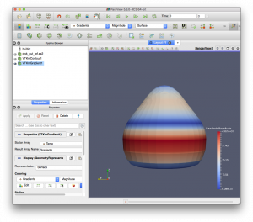
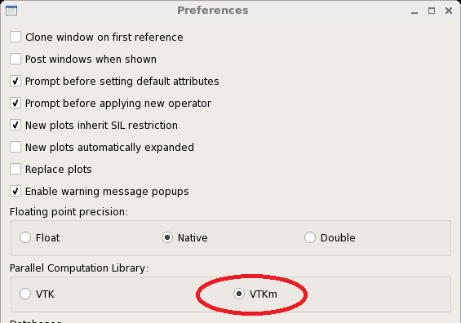
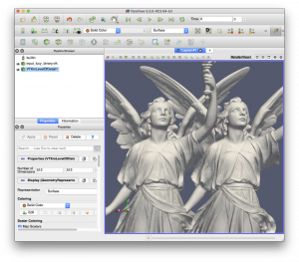

ParaView Plugin for VTK-m
VisIt support for VTK-m
Selecting VTK-m with preferences window
Contour plot w/VTK and w/VTK-m

Slide 18
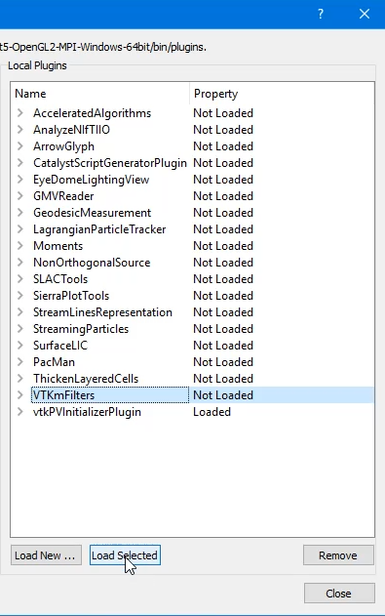
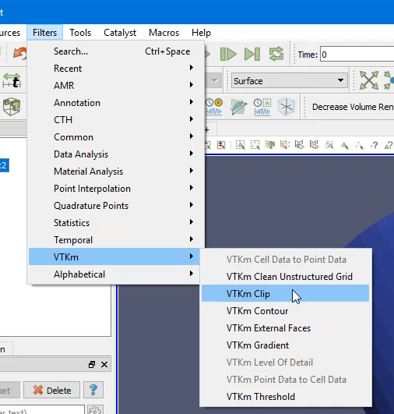
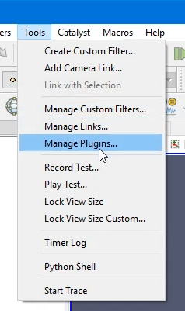
Using VTK-m in ParaView
1. Load VTK-m Plugin
2. Use a VTK-m filter like any other

Slide 19
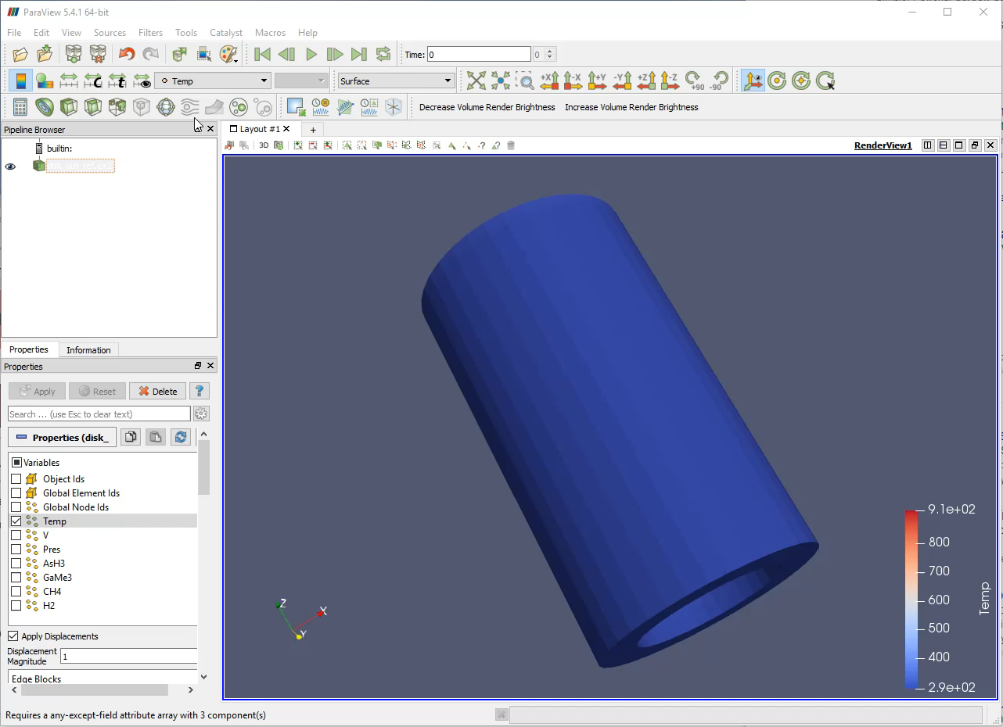

Slide 20
Using VTK-m in VisIt
1. Turn on VTK-m in Preferences
2. Use VTK-m-enabled plots as normal

Slide 21
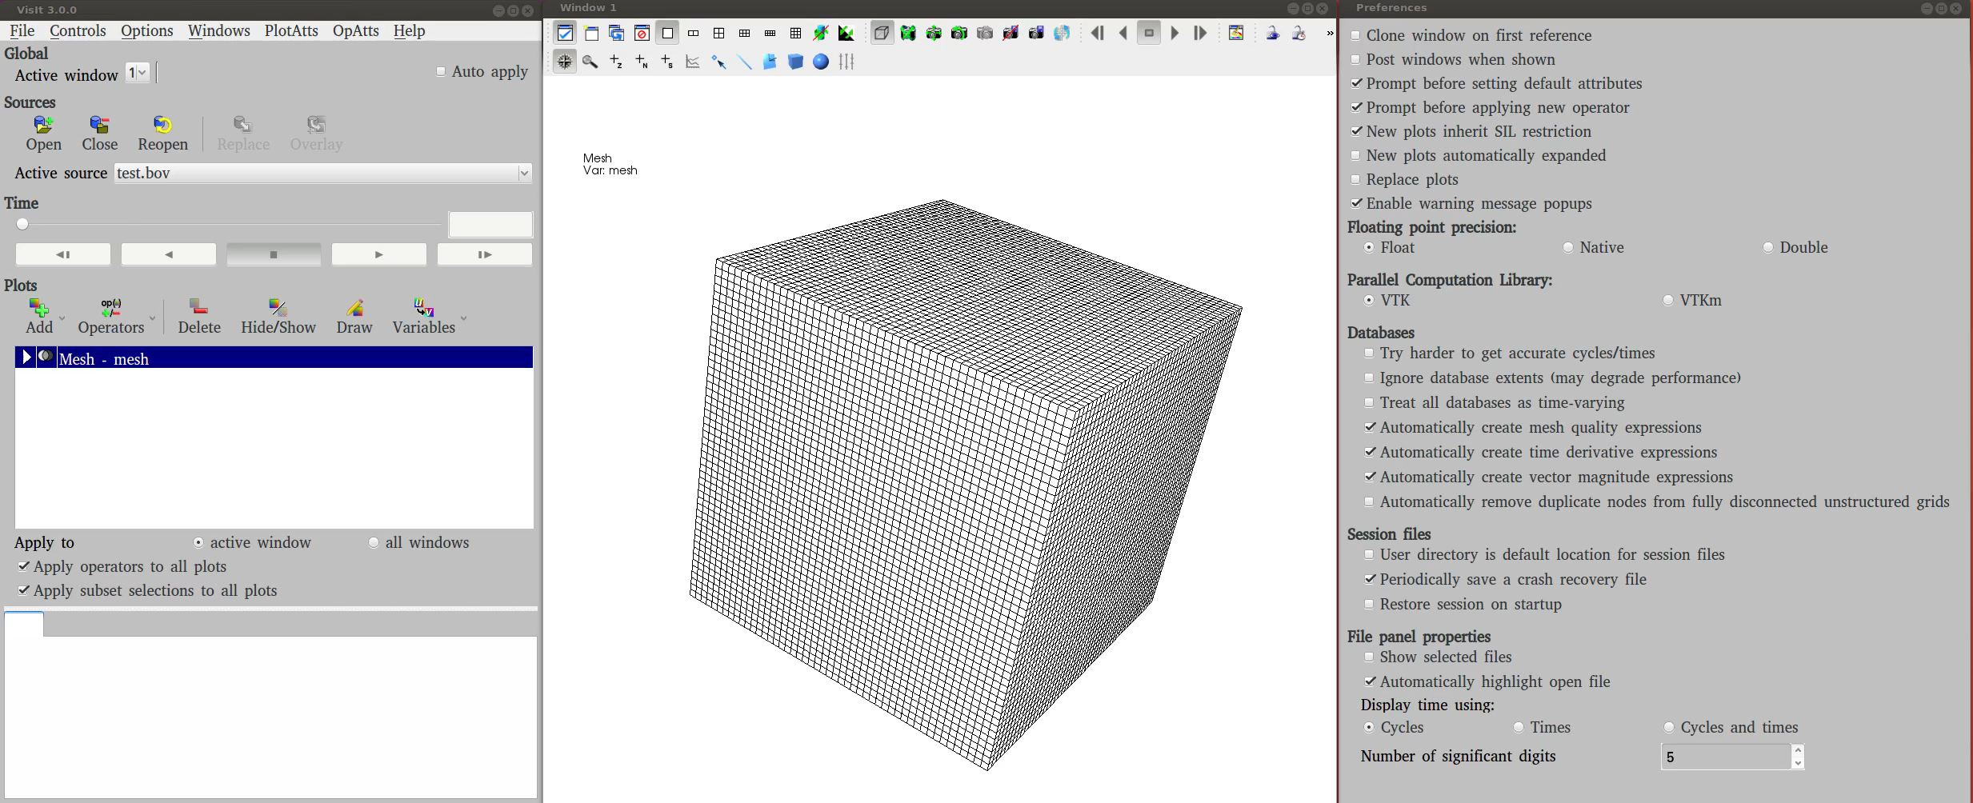

Slide 22
How Do I Use VTK-m?
I develop software that uses (or will use) visualization libraries.

Slide 23
Reader
Filter
Algorithm
Filter
VTK/Accelerators/Vtkm
Simulation
Filter
Rendering

Slide 24
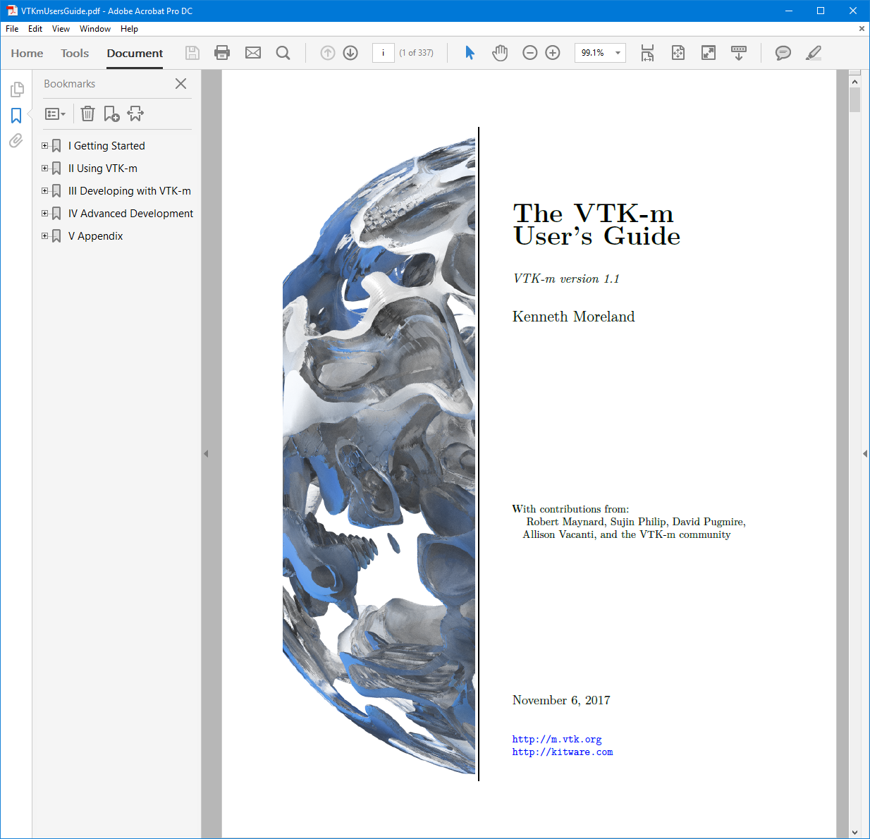

Slide 25
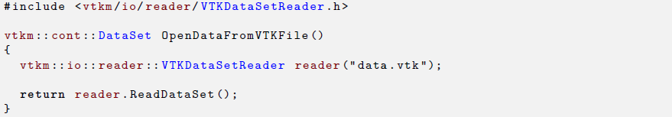
Using VTK-m: Reading Files

Slide 26
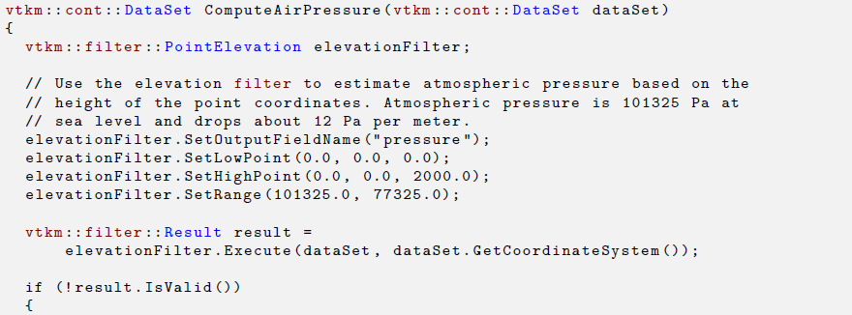
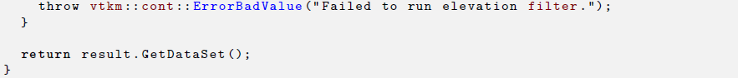
Using VTK-m: Running Filters

Slide 27
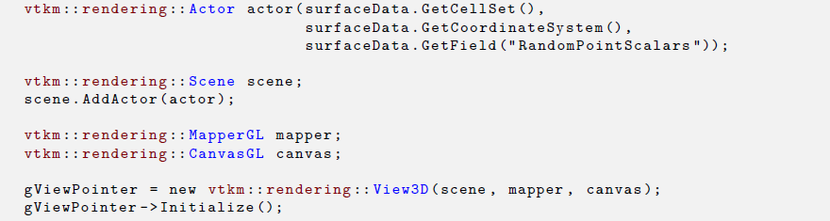
Using VTK-m: Rendering

Slide 28
How Do I Use VTK-m?
I develop visualization software and want to make the leap to many-core devices.

Slide 30
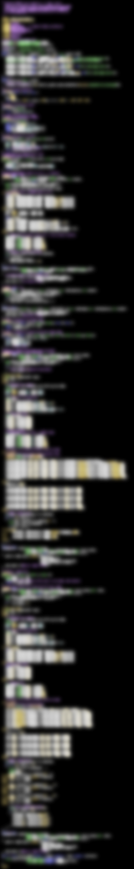

VTK-m
283 Lines
CUDA SDK
561 Lines
Notes:
The source code of Marching Cubes in three different packages. Case tables removed (all essentially the same).
CUDA SDK: marchingCubes_kernel.cu
VTK-m: IsosurfaceUniformGrid.h

Slide 31
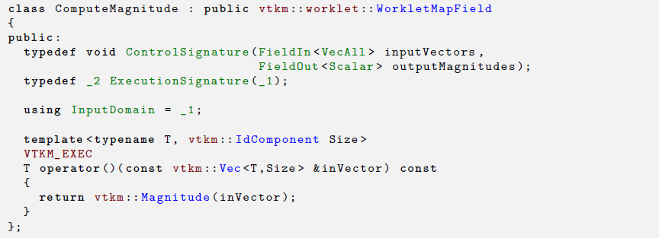

Slide 32
Conclusion
Let us know what further help you would like
Do you want a more focused, more in depth tutorial?
Let us know how to prioritize our development
Is there something in particular you do a lot with ParaView, VisIt, Catalyst, Libsim, ASCENT, etc.?
Is there something that seems to be running slower in ParaView, VisIt, Catalyst, Libsim, ASCENT, etc.?
Is there functionality missing from ParaView, VisIt, Catalyst, Libsim, ASCENT, etc.?

